Slide 1

Parent end of year questionnaire feedback report.
July 2025.

Slide 2

Parent End of Year Questionnaire Report.
This report presents the findings from a survey designed to assess parental perceptions of Pied Piper Preschool's support for children's health, well-being, and overall learning environment. The questionnaire includes a series of questions aimed at gauging satisfaction levels regarding various aspects such as active play opportunities, cleanliness, resource organization, age-appropriateness of activities, adaptability of programs, and inclusivity. As of now, there have been no responses to the survey, which may limit our ability to draw conclusions or identify areas for improvement. Future participation will be crucial in obtaining valuable insights that can enhance the quality of services provided at Pied Piper Preschool.
We received 26 out of 31 completed which is an amazing 86.67% percentage of feedback received!
For the confidentiality of the responses, I have starred out any children’s names. Comments have been written as they had been written in the responses to ensure clarity and truthfulness of responses. Feedback forms are available for anyone to view should you wish.
1: Child's name {Optional}
2: Do you feel that your child enjoys coming to preschool?
Here are the written responses other than yes or no or nothing.
-Yes I think she does.
-He loves it!
-She absolutely loves it! This continues at home, and we do a lot of preschool based games.
-Yes, most of the time.
-Yes he loves it.
-very much so.
-Yes, now he is settled.
-100%
-Yes absolutely loves it! To start with they struggled but now they can’t wait to come in!
-70% of the time.
-xxxxxxx loves preschool once he has arrived, xxxxxxx gets anxious regarding preschool morning but says he has a great day and loves all of his friends and teachers.
-Yes, very much!
-I feel like they love coming to school.
-Yes – getting more and more settled each week

Slide 3
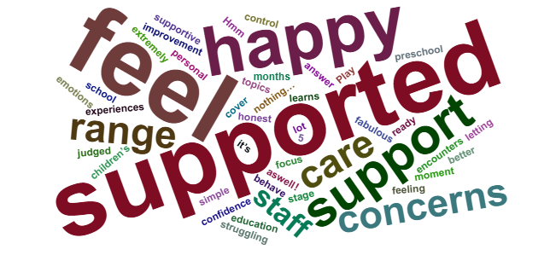
3: What else could we / would you like to see us do to support your child more?
Here are the written responses other than yes or no or nothing.
-To be honest nothing….. You are fabulous with the needs of xxxxxxx and support him really well and you help and support xxxxxx very well as well!
-Nothing really.
-I don’t feel that I could answer this as I am very happy with the range of topics you cover, the range of experiences she encounters. I feel like she learns a lot about personal care and self confidence.
-Over the last 5 months there has been significant improvement all round and I feel xxxxxx is very supported.
-Play but also focus on the older children’s simple education ready for the next stage at school.
-nothing, I know I can come to most staff with any concerns without feeling judged.
-Nothing he is extremely well supported.
-At the moment he is happy.
-Nothing, All the staff are very supportive.
-Can’t think of anything.
-Nothing out of what is already being done.
-Nothing it’s way better now.
-Hmmmm xxxxxx definitely struggling with emotions lately, I don’t know if he behave well at preschool and when he is back home letting it all out. He needs help to control his anger.
-Nothing I feel xxxxxx is fully supported in every area.
-I’m totally happy with how xxxxxxx is supported.
-I cant think of anything
-We haven’t had any concerns with the information that we have seen through tapestry or been made aware of any areas she may need extra support in or raised any with you.
-xxxxxx needs help in eating.
-I assume I would be told if there were any concerns but as a parent I have no way of knowing where my child is at in terms of development against the seven areas in the EYFS.
-Nothing he is well supported.
-Nothing comes to mind. We are really pleased with how you have helped xxxxx and it show that you are taking good care of him.

Slide 4

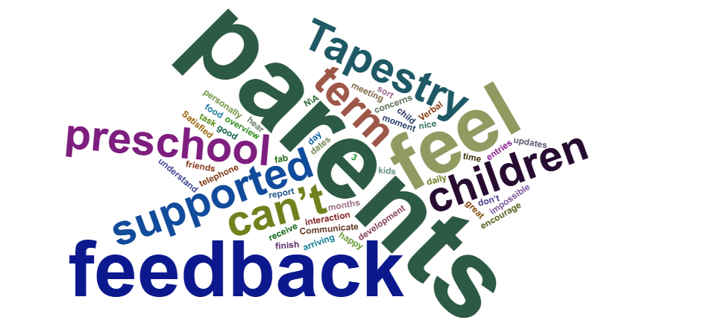
4: Do you feel supported as parents / carers?
Here are the written responses other than yes or no or nothing.
-Again, we haven’t required any support so I can’t answer this really.
-Yes I do and it’s lovely that staff care to ask about my current housing situation.
-Yes definitely lots more communication and help put in place now.
-100%
-Yes, good communication at the start and end of each session, as well as on the email.
-Yes although I would like more individual feedback in terms of how he is getting on as seeing him on sports day, I saw a different side to him when he was interacting with other children.
-100%
-As above, Zanabella has gone above and beyond with supporting us, she’s reassured us we chose the right preschool.
-Don’t get interaction just hello and goodbye, no update of our child face to face unless tapestry is the only communication.
-Yes, I had a few weeks where I thought I could have been supported but that’s my fault for not asking for help. I now feel very supported as a parent and feel confident talking to Zanabella.
-Absolutely yes.
-Some of the time.
-Mostly.
-Yes the catch ups at pick up, tapestry updates, suggestions when asked by email etc – it all makes us feel supported.
5: What could we / would you like us to do to support you more?
Here are the written responses other than yes or no or nothing.
-Maybe more Tapestry updates.
-Help to encourage xxxxxx to finish her food.
-Communicate any concerns with the parents regarding their child.
-At the moment I feel very well supported.
-Maybe more interactions with the parents? Every 3 months giving updates on our kids development etc.
-Nothing, your fab.

Slide 5
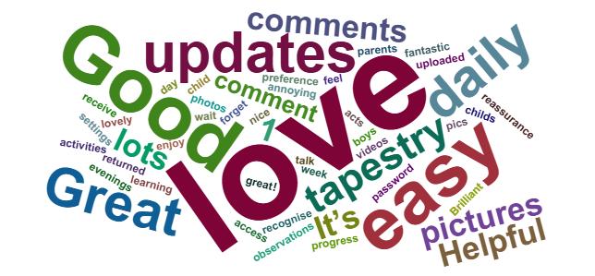
-Maybe a daily overview of what he has been doing.
-Verbal feedback. An end of term meeting maybe face to face or telephone.
-Nothing, you have always go above and beyond with help.
-It would be good to hear some feedback about how the children are getting on at preschool. The Tapestry entries are great but they don’t tell me if the children are happy, getting along, making friends etc. Will we receive an end of term report?
-Keep doing what you are doing.
-Nothing, I feel us parents are also fully supported in every area.
-For me personally I don’t feel you could do any more.
-I can’t think of anything.
-Satisfied.
-Hard to say as it is mostly grandparents that drop off so I do not get to see staff as much but that is on us not preschool.
-Nothing
-Can’t think of anything.
6: Do you feel referrals have been made or suggested in a timely and appropriate manner?
Here are the written responses other than yes or no or nothing.
-Definitely.
-Yes definitely since new management.
7: How do you find Tapestry?
Here are the written responses other than yes or no or nothing.
-I really enjoy Tapestry and receive daily updates on xxxxxx day. It gives me reassurance and shows all the activities she gets up too.
-Love it. I feel we get lots of pics and comments.
-It’s fantastic to see what the children get up to.
-Really good although I would have loved more updates daily.
-Helpful and memorable.
-Hit and Miss, sometimes it’s a bit quiet then other weeks we get lots through.
-Great and easy to use.
-Love it.
-I love Tapestry as I can talk to the boys about what they have done because usually they forget when they get home.
-Good however it can be quite annoying when it doesn’t recognise my password every other week.
-Great but maybe have more 1:1 on there instead of groups.
-Very good / photos updates daily.
-It’s great! I love seeing what they have been up to an the different things they are learning.
-We love seeing all the pictures and videos, it’s nice to see how he acts within groups too.
-I like Tapestry but my preference would be to just see pictures of my child only.
-Fine – clarity over when to use Tapestry versus email would be helpful though.

Slide 6

-Good, easy to use. Would be good to have comments returned if we make a comment.
-Very easy to use, Its lovely to be able to access my childs observations as they are uploaded instead of having to wait in some settings for parents evenings / updates on progress.
-Brilliant.
-I love Tapestry, I love seeing what he gets up to whilst he’s there
-Very good.
-Easy to use.
-Very good
-Great, more regularly updated.
8: How often do you go on? and do you comment or like? If not what could we do to gain your interaction?
Here are the written responses other than yes or no or nothing.
-I like and occasionally comment. And upload pics from outside preschool if I remember.
-Me not so much but his nanny looks regularly as does mum.
-Everyday of attendance as observations of xxxxxx are posted frequently.
-I look at every entry and like them to show that I have seen them. I do not always comment as I don’t feel the need to.
-Everytime there is a post and I comment and like most things.
-I go in when I receive a message but don’t comment.
-Whenever I get an alert to something being put on.
-Whenever I get a notification, but don’t always comment or tick but try too.
-whenever a email is alerted to say an upload has been made.
-When something is uploaded.
-Every notification I get I try to get on.
-I go on everyday to see if anything gets put up and I like every post.
-Everytime something is posted.
-Everyday she is in preschool.
-I go on when notified somethings been added.
-As often as I can.
-I go on everytime I get an email. I like every post and sometimes comment.
-Usually everytime there is a post. I always like.
-Always when I receive a notification.
-Every time I receive a notification and I always like.
-Frequently.
-Whenever an observation is uploaded.
-Yes regularly look and like if I have seen the update
-I look at every notification and try to like of comment mot of the time {always if it’s a message to us specifically}

Slide 7
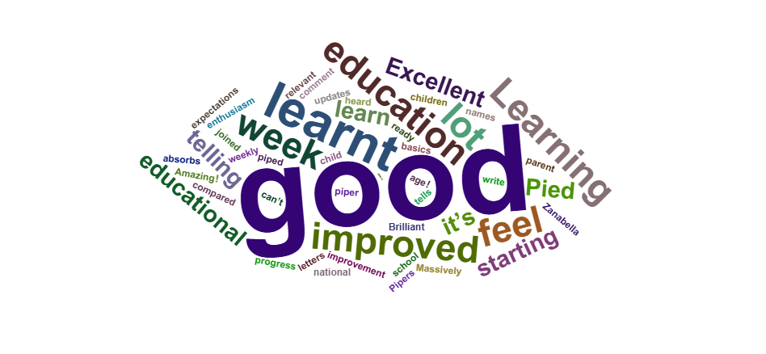
9: How do you find the education at Pied Piper?
Here are the written responses other than yes or no or nothing.
-I think it’s great and has had a lot of improvement recently.
-Amazing!
-This is new to us so I can’t comment but I have heard from another parent that it’s more educational since Zanabella has joined which I welcome.
-Very good.
-Very good, relevant and in line with national expectations.
-xxxxxx has made to much progress since starting at Pied Piper. She absorbs so much from the lessons and loves telling all of her family about what she has learnt.
-Good xxx has learnt a lot.
-I feel xxxxx has learnt lots of new things since starting preschool, her colours have improved, alphabet, songs and she brings home new books each week.
-Excellent, xxxxxx know how to count to 20.
-I believe xxxxxxx has learnt such a lot at Pied Piper so I’m really happy.
-Good, especially as of late.
-Very good.
-I feel there could be a little more early years maths and English and more emotional learning.
-Excellent.
-Very good for their age!
-Brilliant.
-The education at Pied Piper has really improved recently and xxxxxxx tells me what he has learn.
-Learning something new every week as weekly updates for the week ahead. Maybe improvement on the basics ready for school for the older children! Learn to write numbers / letters and their names.
-Massively improved, y child is now telling about what they have been learning with so much enthusiasm compared to before.
-Satisfied.
-More play than education but I feel this has changed over the last few months with more educational games.
-Good.

Slide 8
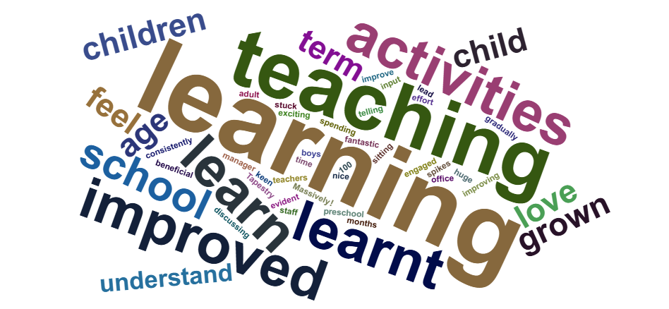
10: Do you feel teaching has improved? if not, how do you feel we could do so?
Here are the written responses other than yes or no or nothing.
-Massively! I knew they were learning before but so much more exciting and seems really engaged and is keen to learn more at home.
-Learning something new every week as weekly updates for the week ahead. Maybe improvement on the basics ready for school for the older children! Learn to write numbers / letters and their names.
-100%
-Yes definitely.
-Yes the teaching is fantastic as both boys love spending time with all the teachers and say how much you help the learn.
-Yes, or perhaps just more information passed on about learning at school.
-Hard to say, not really made aware of what you are covering in maths, English etc.
-I am grateful I found Pied Piper school.
-I feel xxxxxxx has always learnt what is appropriate and beneficial for her age and has gradually increased this year to prepare her for school. Seems like there has been a little bit more spontaneous learning over the last term.
-I think teaching has improve.
-Definitely improved.
-Yes. In the last few months xxxxxx has been discussing so many new things she has learnt. The staff have been making a huge effort to input adult led activities. Xxxxxx has learnt so much over the last term.
-It’s nice to see the preschool manager getting stuck in with the activities as well, and not just sitting in the office.
-It seems to be improving consistently, this has been evident from the things we have seen on Tapestry and from what he is telling us he has been learning at home, teaching seems to be being done in a age appropriate way and ways which spikes their interests to want to learn more.
-I love all the recent new things, like artist of the month.
-it has improved.
-Not sure if it’s improved as always been a high standard but feel there are a variety of different activities being set out for the children to encourage learning
-Can’t comment as no experience of what it was like before.

Slide 9
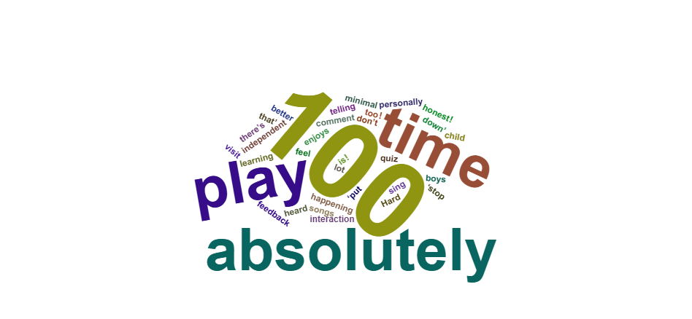
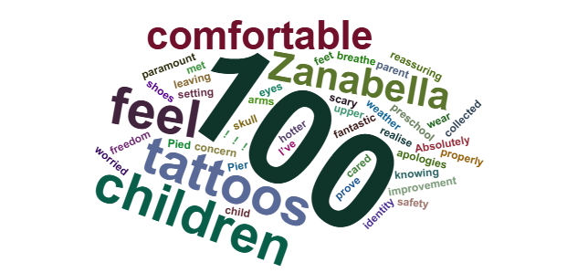
11: Do you feel our teaching is stimulating, engaging and enhances your child's learning?
Here are the written responses other than yes or no or nothing.
-Yes I do.
-Yes 100% he enjoys telling me about quiz time too!
-I believe so.
-Definitely. The boys sing all the songs at home, all the time.
-100%
-Yes absolutely.
-Again not too sure, I think during play there’s minimal interaction a lot of ‘put that down’ ‘stop that’ is what I personally heard during a visit.
-Yes definitely.
-I feel I cannot comment on this as I don’t know how much independent play or one to one learning?
-it absolutely is!
-Yes I think so, mainly from feedback from the child.
-Hard to say to be honest!
12: Do you feel that staff provide a safe environment?
Here are the written responses other than yes or no or nothing.
-100% !!!
-Yes, I’ve always felt very comfortable with leaving xxxxxxx at Pied Piper and knowing she will be well cared for.
-Absolutely.
-I believe so.
-100%
-Yes, although with the hotter weather, I did have a concern that the large tattoos on Miss Zanabella’s upper arms {a face and skull} were perhaps a little scary for the children’s eyes. I realise everyone needs to feel comfortable and I have no problem with tattoos, but there were two that I felt were not right for a preschool setting – apologies.
-100%
-Yes I do. Although one improvement I would like is for children not to wear shoes inside and let their young feet breathe and have freedom to move properly.
-Yes, never feel worried about this.

Slide 10
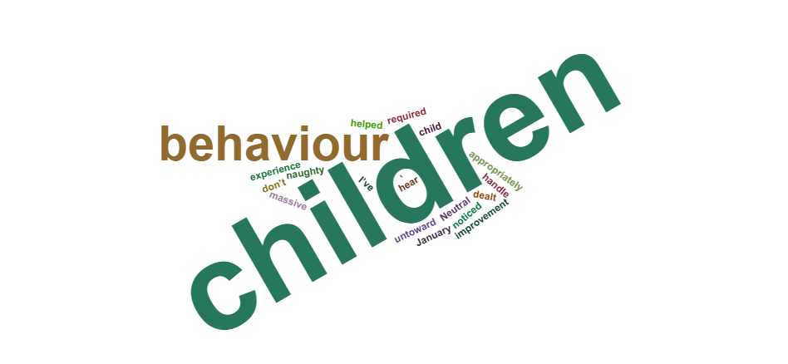
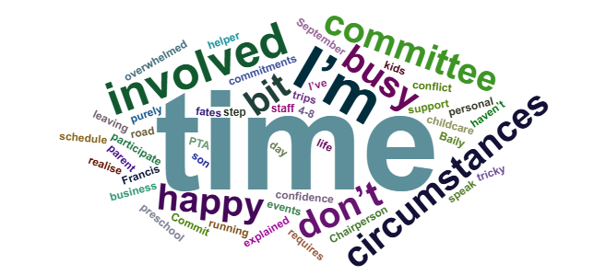
13: Do you feel we have appropriate behaviour management strategies in place?
Here are the written responses other than yes or no or nothing.
-I believe so.
-Yes, I don’t hear the children saying anything untoward about children’s behaviour and if someone is naughty, the children tell me tat things are dealt with appropriately.
-Yes. I’ve noticed a massive improvement in the behaviour of some since January.
-Yes it has helped at home as well.
-I’ve not really had any experience of this.
-Neutral.
-Not sure what they are.
-I don’t know – would be interested to know more about how you handle this.
14: Are you involved with the committee? is this something you would be interested in? if not why not?
Here are the written responses other than yes or no or nothing.
-No, due to not being able to time commitments however am happy to support at events if needed.
-Jonathon is involved. I would have liked to be as well but we both couldn’t leave xxxxxx for the meetings.
-I’m not, I don’t have the time – my husband works late hours so unfortunately isn’t something I have been able to partake in.
-No as I have to work from 4-8.
-Yes, however I may have to step back.
-I’m not involved as don’t have the confidence but happy to help with day trips or fates etc.
-no, too busy already.
-Under different circumstances I would have been.
-No not interested.
-I am a parent and staff member.
-I am not involved purely because I am the chairperson of Francis Baily PTA, up the road and it would be a conflict of interests for me. I have explained this to Miss Zanabella in the past.
-No, busy with work / childcare.

Slide 11

-No, due to circumstances, however I would be interested if I could participate in other ways.
-I am not. I have always felt a bit overwhelmed with life of having kids and running my own business so haven’t felt I’ve had the time to fully commit.
-No my son is leaving in September.
-Not enough time.
-No due to time restraints.
-Yes Mark is {obviously!}. I’m not looking for additional responsibilities at the point in time to be honest.
15: How do you find the amount of information that gets sent out?
Here are the written responses other than yes or no or nothing.
-fine, no problem at all.
-Satisfied.
-Perfect amount, its always clear and concise.
-Very good.
-Reasonable.
-I think the amount of information is good but perhaps timings of emails be considered? Perhaps emails could be put on a ‘scheduled send’ and sent out during the working week, rather than at the weekends, in line with primary schools? Unless in the case of emergency of course.
-Great! Consistent and informative – even the offering of training opportunities for parents.
-I think the information sent out is great and enough to keep us in the loop.
-Very informative and very helpful.
-It’s nice to have the weekly updates of what will be happening.
-Ok.
-Very god weekly updates and that’s improved since new management. Meaning emails stating what topic is being talked about the week ahead
-Great-I love the weekly emails.
-helpful
-Good
-good, weekly news emails and Tapestry are great.
-Good.
-That’s got a lot better.
-Helpful.
-Love the emails we get sent every week.
-Yes, always well informed.
-Informative.
-Good.
-Good.

Slide 12
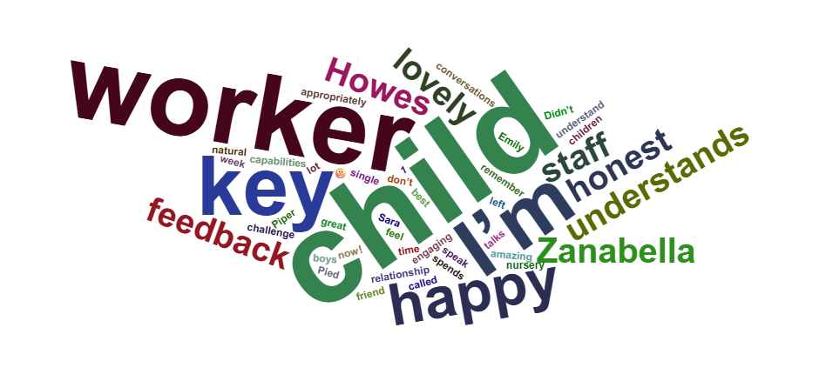
16: Do you know who your child's key worker is? {please leave some feedback on their key worker}
Here are the written responses other than yes or no or nothing.
-Yes. Emily is lovely, she my child talks about her a lot and the conversations or things they have been up to together.
-Yes, I am very happy with xxxxxxxx key worker. She understands xxxxxx and his quirks and xxxxxxx seems very happy.
-It has been sent out in a email recently, so I have the information but not off the top of my head.
-Yes, Mrs Cherun and she is lovely, kind and approachable.
-Yes, but only get feedback from Zanabella. Seems like she spends more time with my child, which I’m happy about due to the relationship her and my child have.
-I don’t actually know.
-I can’t remember but every single member of staff are great.
-No, I’m not sure who has taken over with xxxxxxx since Sara left.
-Yes, very engaging with my child and I feel I can speak to their key worker if needed.
-Yes, no much to say at the moment, she is nice.
-Mrs Down is xxxxxxx key worker and I know xxxxxx absolutely thinks the world of her.
-Didn’t but do now.
-Yes, Mrs Howes.
-Yes – Mrs Down – she’s amazing, such a natural nursery worker and so kind with the children. The boys have called her their ‘best friend’ from week 1 of being at pied piper.
-I do now! Although I’m not sure who it exactly is.
-I think so, but to be honest every member of staff seems to know my child inside and out, they all seem to know and understand his capabilities and challenge him appropriately.
-Yes… she is doing a good job.
-I do now.
-Yes – Mrs Howes is a brilliant key worker, kind and caring.
-No specific feedback but I’m confident she will have done what she can do to help him settle.

Slide 13

17: What made you choose to send your child to Pied Piper?
Here are the written responses other than yes or no or nothing.
-It was local and heard it was good but it was okay w’s under new management.
-When visiting it felt safe, secure and I was reassured that xxxxxx emotional wellbeing would be the main priority.
-Recommendations and a very warm, welcoming and assuring visit.
-My older son xxxxxxxxx came her 3 years ago.
-Local to area and always been told positive things about it.
-Very good recommendations.
-Reputation, ethos, size and feel.
-I knew of other parents with slightly older children who raved about Pied Piper. I also attended myself and knew some of those staff members stayed there a long time.
-Previous experience.
-Great location / many people I know have been to this preschool or their children have gone there.
-Phenomenal reviews.
-xxxx attended for 2 years and I thought it was great so decided to send xxxxxxx and I’m happy with my decision.
-Lovely small family feel preschool, all my children have gone here.
-I sent my older two there and I loved the close knit feel and agree with the values.
-My little sister came there and she loved it so I thought I’d try with the boys and they are loving it.
-My eldest went there, it had a very homely feel.
-The first thing that brought me there is because it is owned by the methodist church.
-I liked the vibe when I visited.
-Location, reputation, feel when I looked around.
-I loved the environment, the atmosphere and the overall feel of it.
-Because I like the environment being in a easily accessible place and because it belongs to a church.
-Previously child attended.
-It’s an affordable additional day of childcare to help my parents on the day they are due to have both our boys. Versus another local preschool we liked that Pied Piper includes educational aspects and not just free play.

Slide 14


18: Do you feel able to approach staff with any concerns or questions?
Here are the written responses other than yes or no or nothing.
-Sometimes.
-Yes, although would probably find it easier to talk to some more than others.
-Absolutely.
-Yes I believe so.
-I would 100% talk to Zanabella and a few other staff.
-Key worker yes.
-Yes I always feel happy to do this and know it’ll be sorted.
-Most staff, some are more approachable than others, sometimes it feels like I might be judged.
-Yes without a doubt.
-Always.
-Absolutely.
-Yeah very friendly.
-Yes always.
19: Do you feel we act appropriately with safeguarding concerns or welfare concerns?
Here are the written responses other than yes or no or nothing.
-100%
-100%
-Yes, and seems to be taken more seriously now like ID being checked when someone new collected my child.
-100%
-N/A I have not had to experience this, thankfully.
-Again not much experience of this but I wouldn’t doubt that you do ☺
-I think so, I don’t know of any concerns.

Slide 15
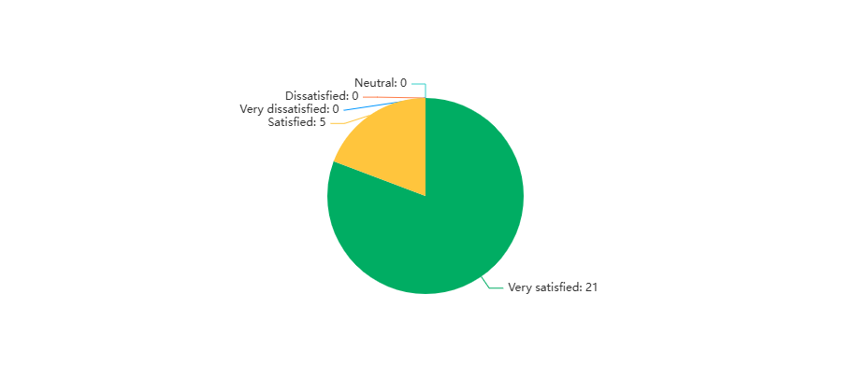
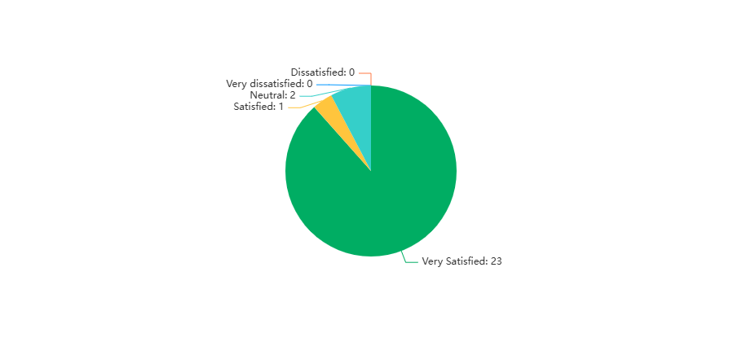
20: Do you feel Pied Piper supports you child's health and well-being needs?
Analysis Conclusion: The survey results indicate a strong positive perception of Pied Piper's support for children's health and well-being, with 80.77% of respondents feeling "Very satisfied" and 19.23% feeling "Satisfied." The absence of any neutral, dissatisfied, or very dissatisfied responses suggests a high level of confidence among the participants regarding the organization's efforts. To improve, Pied Piper could consider gathering more detailed feedback from the satisfied respondents to identify specific strengths and areas for enhancement. Additionally, conducting follow-up surveys that explore other aspects of health and well-being services could provide a more comprehensive understanding of community needs and expectations.
21: Do you feel Pied Piper provides plenty of opportunities for active play?
Analysis Conclusion: The survey results indicate a strong positive perception of Pied Piper's support for children's health and well-being, with 80.77% of respondents feeling "Very satisfied" and 19.23% feeling "Satisfied." The absence of any neutral, dissatisfied, or very dissatisfied responses suggests a high level of confidence among the participants regarding the organization's efforts. To improve, Pied Piper could consider gathering more detailed feedback from the satisfied respondents to identify specific strengths and areas for enhancement. Additionally, conducting follow-up surveys that explore other aspects of health and well-being services could provide a more comprehensive understanding of community needs and expectations.

Slide 16

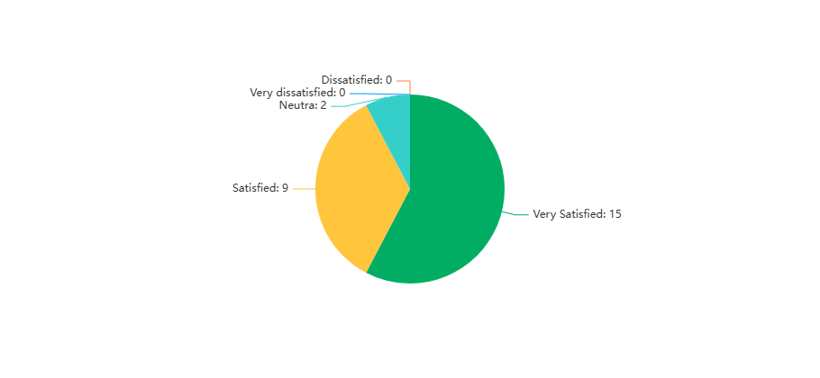
22: Is Pied Piper kept in a clean and tidy manner?
Analysis Conclusion: The survey results indicate a strong positive perception of Pied Piper's support for children's health and well-being, with 80.77% of respondents feeling "Very satisfied" and 19.23% feeling "Satisfied." The absence of any neutral, dissatisfied, or very dissatisfied responses suggests a high level of confidence among the participants regarding the organization's efforts. To improve, Pied Piper could consider gathering more detailed feedback from the satisfied respondents to identify specific strengths and areas for enhancement. Additionally, conducting follow-up surveys that explore other aspects of health and well-being services could provide a more comprehensive understanding of community needs and expectations.
23: Is equipment and resources provided appropriate and well-organised to optimise learning?
Analysis Conclusion: The survey results indicate a strong positive perception of Pied Piper's support for children's health and well-being, with 80.77% of respondents feeling "Very satisfied" and 19.23% feeling "Satisfied." The absence of any neutral, dissatisfied, or very dissatisfied responses suggests a high level of confidence among the participants regarding the organization's efforts. To improve, Pied Piper could consider gathering more detailed feedback from the satisfied respondents to identify specific strengths and areas for enhancement. Additionally, conducting follow-up surveys that explore other aspects of health and well-being services could provide a more comprehensive understanding of community needs and expectations.

Slide 17
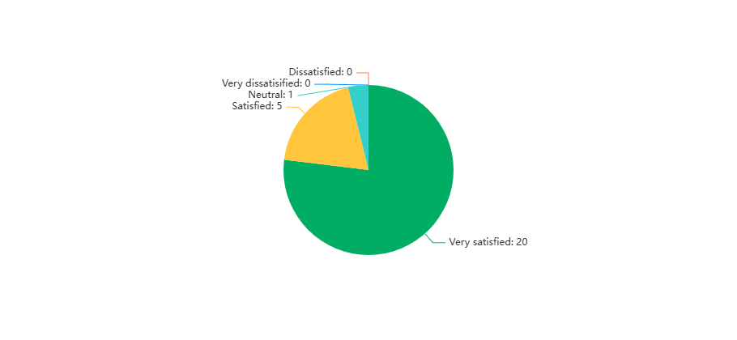
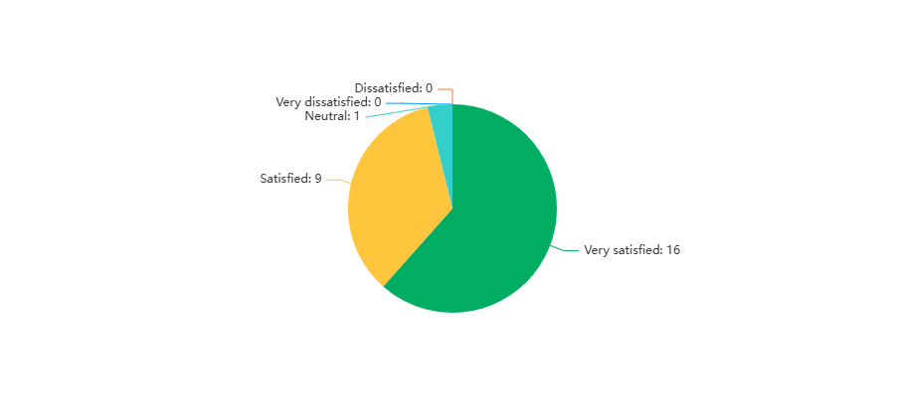
24: Do you feel activities are age and stage appropriate?
Analysis Conclusion: The survey results indicate a strong positive perception of Pied Piper's support for children's health and well-being, with 80.77% of respondents feeling "Very satisfied" and 19.23% feeling "Satisfied." The absence of any neutral, dissatisfied, or very dissatisfied responses suggests a high level of confidence among the participants regarding the organization's efforts. To improve, Pied Piper could consider gathering more detailed feedback from the satisfied respondents to identify specific strengths and areas for enhancement. Additionally, conducting follow-up surveys that explore other aspects of health and well-being services could provide a more comprehensive understanding of community needs and expectations.
25: How well do you feel we adapt activities for the ability of your child?
Analysis Conclusion: The survey results indicate a strong positive perception of Pied Piper's support for children's health and well-being, with 80.77% of respondents feeling "Very satisfied" and 19.23% feeling "Satisfied." The absence of any neutral, dissatisfied, or very dissatisfied responses suggests a high level of confidence among the participants regarding the organization's efforts.To improve, Pied Piper could consider gathering more detailed feedback from the satisfied respondents to identify specific strengths and areas for enhancement. Additionally, conducting follow-up surveys that explore other aspects of health and well-being services could provide a more comprehensive understanding of community needs and expectations.

Slide 18

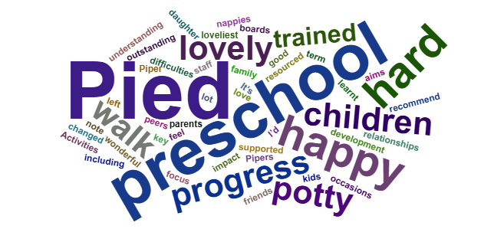
26: How inclusive do you feel Pied Piper Preschool is?
Analysis Conclusion: The survey results indicate a strong positive perception of Pied Piper's support for children's health and well-being, with 80.77% of respondents feeling "Very satisfied" and 19.23% feeling "Satisfied." The absence of any neutral, dissatisfied, or very dissatisfied responses suggests a high level of confidence among the participants regarding the organization's efforts. To improve, Pied Piper could consider gathering more detailed feedback from the satisfied respondents to identify specific strengths and areas for enhancement. Additionally, conducting follow-up surveys that explore other aspects of health and well-being services could provide a more comprehensive understanding of community needs and expectations.
27: Would you like to comment on any of your responses in the last section?
Here are the written responses other than yes or no or nothing.
-Pied Piper is a god place for young kids.
-Pied pipers has had an outstanding impact on xxxxxx overall development and understanding. She has such wonderful relationships with all of the staff, has made some lovely friends within her peers and she has learnt this last term especially.
-The preschool seems well resourced and it has a lovely family feel..
-It’s the loveliest little preschool and I’d recommend to anyone.
-Very happy.
-I would like to note on a few occasions whilst my daughter was in nappies she left the preschool with it so heavy it was hanging down her legs making it almost difficult to walk. Obviously I appreciate it can be hard to time manage things like this and it was never an issue before as my eldest was potty trained before starting but I think if you have younger children who aren’t yet potty trained things like this should be monitored more closely so it isn’t causing them discomfort.
-I love seeing the progress that children who might have difficulties are supported so they can join in. It must mean a lot to their parents.
-Hard to answer some questions as I am not in the school environment but happy with everything at Pied Piper!
-Can’t comment on storage of resources as haven’t seen it.

Slide 19
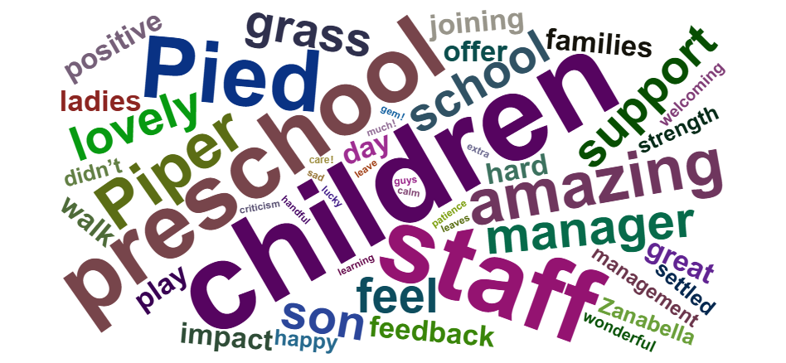
28: Any other feedback or comments you would like to make?
Here are the written responses other than yes or no or nothing.
-Pied Piper is a little gem! Families are lucky to be there and have the amazing support that the staff offer. The care is exemplary and the passion that staff have for their jobs and children is truly amazing! We have seen a huge positive impact with the new manager joining, and the progress my child has made is great. Well Done!!!
-When I looked around it was just before the old manager left, I was in two minds as I felt that she potentially was talking the talk and I didn’t have a feeling that she could walk the walk, I met Zanabella and felt instantly comfortable with how honest and open she was, it really settled my mind and I knew I was making the right choice. The preschool seems to be going from strength to strength, teaching ahs massively improved and I feel that it felt like a playschool initially now it feels like it most definitely a preschool. Well done ladies you should be proud of the work that you do the impact that you have is amazing to be witness of!
-Pied Piper staff have always been so supportive, welcoming and caring for my son.
-Thank you for looking after or son.
-I would be keen to know how the boys get on with each other in this setting and how do they interact with other children? Do either of them have other friends? Has xxxxx had a go at using left handed scissors? Do they eat and drink well when they are there? More day to day feedback like this would be good, at the end of each term / year. Thank you for all your hard work, the twins are very happy to come to preschool every week.
-As a parent and the deputy manager of the preschool – I can honestly say I couldn’t be more proud of the choices I made not only for xxxxxx but also myself. The staff are 100% dedicated to the well-being and education of the children and xxxxxx settled in so quickly due to it being such a warm and welcoming environment. Xxxxxx has come on leaps and bounds since starting at Pied Piper. She has developed lovely friendships amongst peers, is fully engaged in lots of activities and even with my presence – will approach all of the other staff members without question. Such a wonderful little preschool that both me and xxxxxx are proud to be a part of.
-Nothing, other than a big thank you for all being so wonderful and making my daughter feel so excited to come to preschool.
-New management is absolutely amazing and very helpful.
-Grateful to Pied Piper for helping to prepare my son for big school.
-On thing I used to notice is they weren’t allowed on the grass throughout winter last year, I get the grass gets ruined but it didn’t give them much space to play. I’m not sure what can be done regarding keeping the grass nice but it didn’t seem fair on the children.
-thank you very much for the amount of patience and support you offer xxxxxx! He can be a handful but you guys are doing amazing and I feel amazing and calm when I leave him in your care! Thank you so much!
-Only to say that I’ll be very sad when xxxxxx leaves and goes to school. Thank you for everything.
-xxxxxx has come on a great deal since joining Pied Piper in terms of her confidence, thank you for all your hard work and we will miss you.
-Thank you for all your help and support ☺
-My feedback comes from a positive place regarding extra learning for the older children not a criticism. Thank you.
-Thank you to all staff-xxxxxxx talks about every single one of you with such fondness and I know she will miss you all and I will miss bringing her!
-Both our children have loved being here and we you all when we leave! Thank you
-We’re really happy with how things are going so far, Thank you

Slide 20
Conclusion.
Analysis Conclusion: The survey results indicate a strong positive perception of Pied Piper's support for children's health and well-being, with 80.77% of respondents feeling "Very satisfied" and 19.23% feeling "Satisfied." The absence of any neutral, dissatisfied, or very dissatisfied responses suggests a high level of confidence among the participants regarding the organization's efforts. To improve, Pied Piper could consider gathering more detailed feedback from the satisfied respondents to identify specific strengths and areas for enhancement. Additionally, conducting follow-up surveys that explore other aspects of health and well-being services could provide a more comprehensive understanding of community needs and expectations.
So, following the feedback that the responses to this survey gave us what can be do OR what will we be doing?
1}Look at the practicalities of children being bear foot inside the building or having the option to wear slippers / slipper socks.
2}Due to the way the start and end of session are it would be physically impossible to give every parent a hand over of their child’s day, so we will be looking at purchasing a white board that we will write an overview of what they have been up too. I will also start to attach the weekly planning to the weekly news emails so that you can see what activities that are planned for the children to have the opportunity to participate in.
3}A maths handbook was created and sent out to all parents please let me know if you didn’t receive this and I will resend. I will, over the summer create a similar one for literacy. However, I would like to reassure parents that there is always maths and literacy activities out every day and in also incorporated into every group time too.
4}Keyworkers – an email has been sent out to reconfirm who is your child’s keyworker, if you aren’t sure who is who please ask or look on the board along the corridor on your way out.
5}Emotional awareness – We use the colour monster and have numerous different ways of supporting children to understand and regulate their emotions. We also us breathing techniques to help calm children down if we need too. I will be creating videos of the different techniques and will email these out. We also use yoga and mindfulness activities.
6}Children in nappies are changed around 11am.

Slide 21
6}Development checks and reporting. Every observation is cross-referenced with both the Early Years Foundation stage and Development Matters frameworks. I will discuss with the staff team about mid year and end of year reports, or the possibility of a parents evening style mid year.
7}In regard to tattoos, I do keep them covered as much as possible but in the heat, my health and wellbeing was more important, in the 15years I have had them I have never had a child scared of them and I specifically choose skulls that aren’t scary. They get used as a tool to teach children not to judge and spikes their interests which in turn causes them to ask questions and comment on what they can see. They have been used for colours, shapes learning about different cultures like the day of the dead festival in Mexico that is a beautifully positive festival that celebrates the lives of people that have passed. Tattoos are an everyday vision now-a-days and the stigma behind someone having tattoos is no longer relevant, unless obviously they are offensive. We now have work t-shirts that I will be wearing as will the other staff that have opted to have them, when I am working with the children however these do not fully cover them. I have taken the concerns on board but would like to reassure parents that no child has ever been scared or shown it verbally or non-verbally to be so.
8}Over the course of the summer holidays I will send out our key policies and procedures that parents should be aware of, this will inform you of behaviour management, safeguarding protocols, emergency closures etc.
9}If you need to send any messages and require a definite response please do this via email and not Tapestry as we don’t always get alerted to messages or pictures being added by parents.
Thank you to each and everyone of our families for taking the time to complete the questionnaires and being as open and honest as you have been. Please remember if you have any questions or concerns, please don’t wait for the next questionnaire {Dec / Jan} please speak to a staff member or myself, or email in.
Thank you for supporting our amazing little preschool and its AMAZING staff team!
Zanabella

